Slide 1
HW1 : Modules

Slide 2
Requirements
Hardware
Intel’s Sandybridge and above
https://en.wikipedia.org/wiki/List_of_Intel_CPU_microarchitectures
Nvidia graphics card supporting CUDA
https://developer.nvidia.com/cuda-gpus
Software
Visual Studio 2022
Intel oneAPI Base Toolkit
https://www.intel.com/content/www/us/en/developer/tools/oneapi/toolkits.html#base-kit
Nvidia’s latest CUDA toolset for your specific graphics card
CUDA 12.2/12.4 🡪 Determine what latest cuda runs on your compute
ImageJ : To view images
Spec your system
Speccy : https://www.ccleaner.com/speccy/download
cpuz

Slide 3
Software
We are dealing with 3 companies:
Microsoft visual studio, Nvidia Cuda, Intel’s oneApp
Your computer (With different hardware)
Each company’s software runs on a different version supporting different hardware
You have to figure out what version runs for your computer
Start with and check if they work
on my laptop, Working conditions:
Visual studio 2022
Intel’s OneApp Working
Cuda 12.2 working

Slide 4
HW-1
Setup-Environment
Visual studio
CUDA
Intel one API toolkit
Software
imageJ : To view images
https://imagej.nih.gov/ij/download.html
Speccy : https://www.ccleaner.com/speccy
Run it on your computer and store the image of cpu and gpu in the hw folder
Open provided project: Verify they all work
Invert8c : C Program
Invert8sse : invert program
Invert8cuda : Cuda program
Implement add
Add 2 8-bit images
View the following webinar up to 35 min mark:
Intel architecture day 2021
https://www.youtube.com/watch?v=3jU_YhZ1NQA

Slide 5
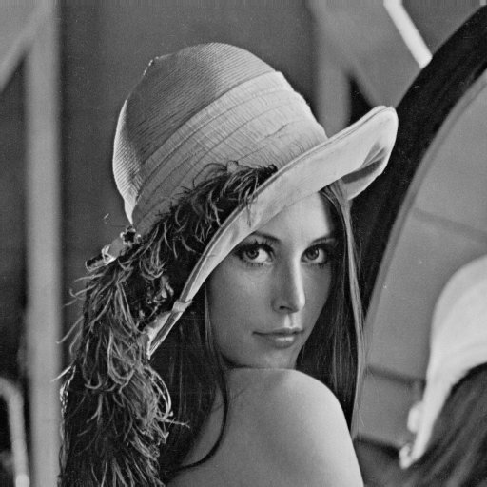
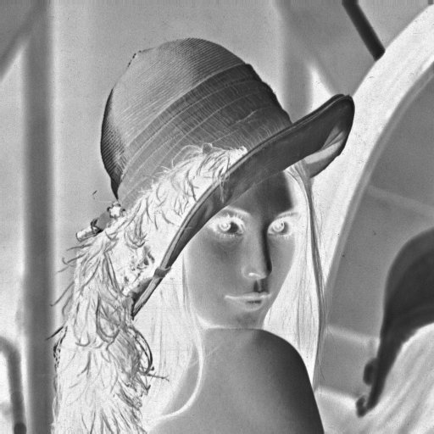
Invert
Output = 255 – invert

Slide 6
Add
Add two images : Output = input0 + input1
Blending, Overlaying
Also for verifying results:
E.g., for invert module, input+output should be 255.

Slide 7
Add
Add two images : Output = (input0 + input1)
Three options:
Add two 8-bit images and store 8-bit result : output = (input0 + input1)/2
Unsigned char *image0;
Unisgned char *image1;
Unsigned char*outimage;
For(i=0;i<imagesize;i++{
Outimage[i]=(image0[i] + image[1[i])/2;
}
2. Add two 8-bit images. Output is 16-bit image
Output = (input0 + input1)
Unsigned char *image0;
Unisgned char *image1;
Unsigned short *outimage;
For(i=0;i<imagesize;i++{
Outimage[i]=image0[i] + image[1[i];
}
3. Add two 8-bit images. Output is 8-bit image
Output = (input0 + input1)
Unsigned char *image0;
Unisgned char *image1;
Unsigned char *outimage;
Unsigned int temp;
For(i=0;i<imagesize;i++{
temp = image0[i] + image[1[i];
outimage [i] = temp>255? 255, temp;
}

